Slide 1

Tip of the Iceberg: Low-Associativity Paging (Nirjhar Mukherjee)
Aiman Malik (2021-CE-23)
Ayesha (2021-CE-18)
Samreen Razzaq (2021-CE-13)
Urwah Imran (2021-CE-15)

Slide 2
Outline
Abstract
Introduction
State of the Art
Analysis
Iceberg Hashing
Implementation
Page Tables
Prototype and Experiments
Experiments, Tuning, Results
References
LRU Design
Conclusion

Slide 3

Abstract
Virtual Address Translation- Growing bottleneck for large data applications
TLBs and Limited Coverage- Struggles to deal with virtual memory
Introduction to Iceberg Hashing- Successful addressing of flaws
Empirical Evidence- Presents a study using xv6

Slide 4
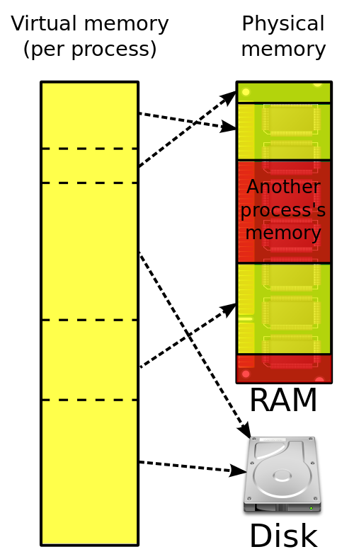
Introduction
Translation Lookaside Buffer
TLB Coverage issues
Huge pages and its downsides
Full and Low Associativity
Conflicts and Fullness Threshold

Slide 5

State of the Art
Mechanism for associativity:
Bucket
Collision
Load factor
Hashed paging schemes
Single Left
Greedy Cuckoo

Slide 6
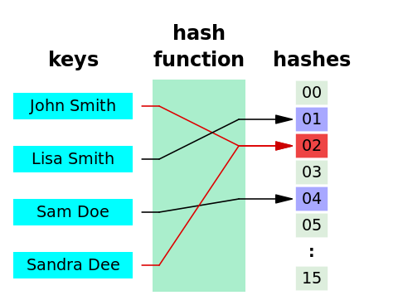
Types of Hashing
Single Hashing:
Single hashing uses a single hash function to turn an input into an output.
h+O√hlog(n)
Greedy Hashing:
An improvement over single hashing, uses multiple hash functions and aims to reduce the chance of collisions.
O(h) + loglogn / logd + O(1)

Slide 7
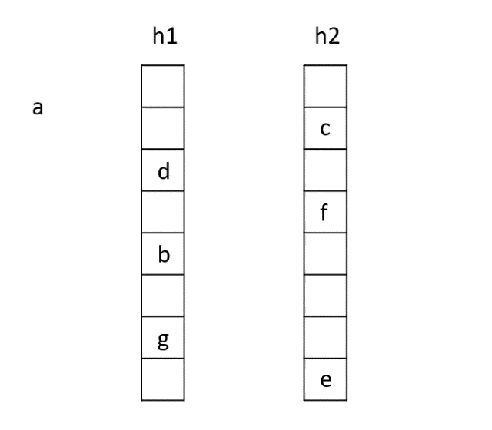
Left Hashing:
Left[d] utilizes multiple hash functions like Greedy[d], but distinctively, in case of a tie Left[d] consistently selects the leftmost bucket.
O(h) + loglogn / (d * φd) + O(1)
Cuckoo Hashing:
Two different hash functions are employed to identify two potential buckets and handle collisions.
No load factor

Slide 8
Analysis
Single Hashing:
High memory overhead
Increasing bucket size reduces memory overhead
Greedy and Left Hashing:
Low memory overhead
Issues with load factor bounds
Cuckoo Hashing:
Low memory overhead
Issues with page allocation

Slide 9
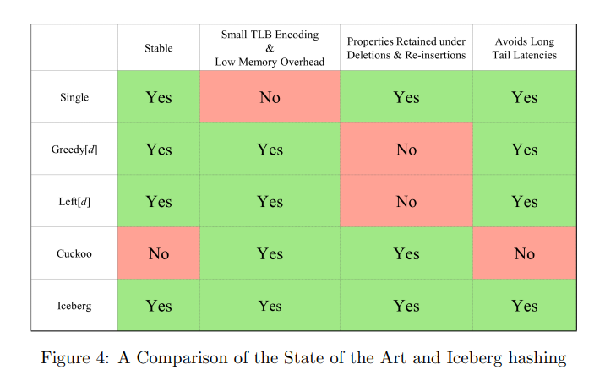

Slide 10

Iceberg Hashing
Introduction to Iceberg Hashing:
Combination of single hashing and left hashing.
Filtering out irrelevant data during query processing.
Stable and able to use very small buckets for data storage.
TLB Entry Reduction:
Reduces TLB entries to a handful of bits per page.
Helps lower memory overhead associated with maintaining translations.

Slide 11
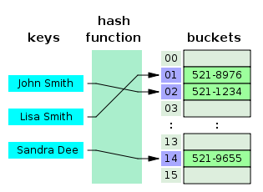
Iceberg Hashing Algorithm
Attempt to allocate a page to a bucket using single hashing; if successful, mark the page as Level-1.
If Level-1 is full, try to allocate using Left[d] hashing, considering only Level-2 pages to determine emptiest bucket; mark the page as Level-2.
If both Level-1 and Level-2 attempts fail, place the page in the bucket chosen by single for Level-1 insertion and mark as Level-3.

Slide 12
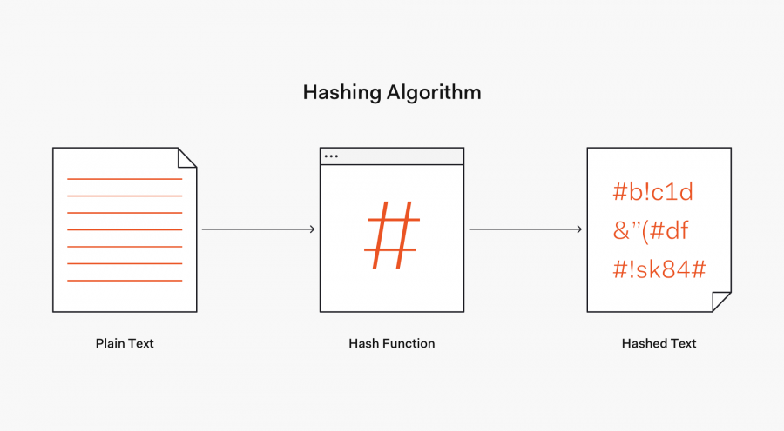
Theorem
Consider an iceberg hashing scheme with n buckets, in which, we run an infinite process of inserting and deleting pages. Then, with high probability at every moment in time, the fullest bucket has h+O(log log n)+o(h)+O(1) pages, where h is the average number of pages per bucket.
Smart way of managing dynamic collection of pages
Smoothness guarantees of left hashing
Enables Low memory overhead and Low associativity
.

Slide 13

Implementation Details
Boot and Iceberg Hashing Integration
Boot process overview: bootloader initializes CPU, loads kernel, and establishes memory connections.
Challenge of integrating "iceberg hashing" into the kernel during boot.
Proposed solution: incorporate iceberg hashing into user-space
memory, avoiding bootloader complexities.

Slide 14
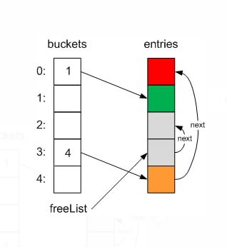
Memory Management with Freelist and Buckets
Kernel's initiation of a freelist for efficient memory allocation.
Introduction of "buckets" for iceberg hashing: a global array with two levels.
Pages beyond the 4MB boundary are organized into buckets, assigned to specific levels and freelists.

Slide 15
Efficient Page Allocation
Differentiating between kernel ("kalloc()") and userspace ("ihalloc()") page allocation.
Userspace allocation involves unique key generation and seed-based bucket selection.
Page freeing: "kfree()" to overall freelist, "ihfree()" to assigned buckets, with utilization variable adjustment.

Slide 16
Page Tables
Overview of Page Tables and Iceberg Hashing
Introduction to Page Tables: focus on encoding, lookup, and storage.
Iceberg hashing's efficiency: using minimal bits for page mapping.
Key components: Hash Seed for hash function, Bucket Offset for bucket position.

Slide 17
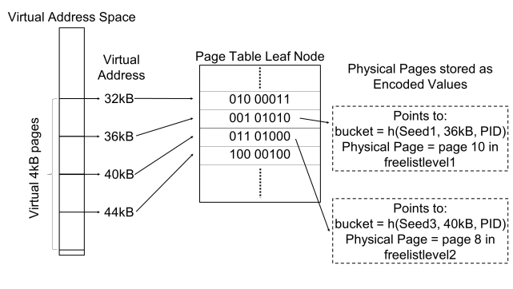
Minimal Fixed – Length Encoding and TLB Efficiency
Proposal for minimal encoding: 3 bits for Hash Seed, 5 bits for Bucket Offset.
Simplification of storing information in page tables.
Versatility in encodings highlighted; recommendation for a 6-bit scheme.
Emphasis on compact representation's benefits for TLB: memory savings and improved coverage.

Slide 18
Xv6 Prototype and States
Implementation in Xv6 Kernel
Focus on Allocation
System State Division
Initial state
Steady state

Slide 19
Experiments, Tuning, Results
Bucket size
Benchmark details
Impact of iceberg parameter
Associativity conflict

Slide 20
LRU Design
Horizon LRU Design
Enforcing a Horizon Condition
Eviction Rule
Mapping Range of a Virtual Address
Ghost Pages

Slide 21

Conclusion
Using low-associativity paging with iceberg hashing being practical and effective.
Collaboration between theory and systems researchers to meet the real-world needs of an operating system.
Keeping a small spare capacity (less than 5%) is enough to prevent issues caused by associativity conflicts.
Future work explores aspects like shared mappings.
Page lookup interaction with the TLB (Translation Lookaside Buffer).

Slide 22
References
Skylake (client) - Microarchitectures - Intel. https://en.wikichip.org/ wiki/intel/microarchitectures/skylake_(client). 2016.
Michael M. Swift. “Towards O(1) Memory”. In: Proceedings of the 16th Workshop on Hot Topics in Operating Systems (HotOS). Whistler, BC, Canada, 2017, pp. 7–11. doi: 10.1145/3102980.3102982. url: http: //doi.acm.org/10.1145/3102980.3102982.
Mel Gorman. Linux Huge Pages. https://lwn.net/Articles/375096/. 2010.

